Slide 1


Learning
React JS

Slide 2




Slide 3


</>
React JS
{}

Slide 4
React JS
ReactJS is a JavaScript library for building user interfaces, particularly for single-page applications (SPAs) where data changes dynamically without requiring a page reload. It was developed by Facebook and is now maintained by Meta and a community of developers.it allows developers to build reusable UI components
</>
{}

Slide 5
SPA
Component
Virtual DOM
Rich Ecosystem

Slide 6
SPA
A Single Page Application (SPA) is a type of web application or website that operates within a single web page, dynamically updating content as users interact with it—without requiring a full page reload. Instead of loading new pages from the server each time the user navigates, an SPA rewrites parts of the existing page using JavaScript, providing a smoother and more responsive user experience similar to a native app
Dynamic Content Loading
Single HTML Entry Point
Improved User Experience
Client-Side Rendering

Slide 7

























Slide 8
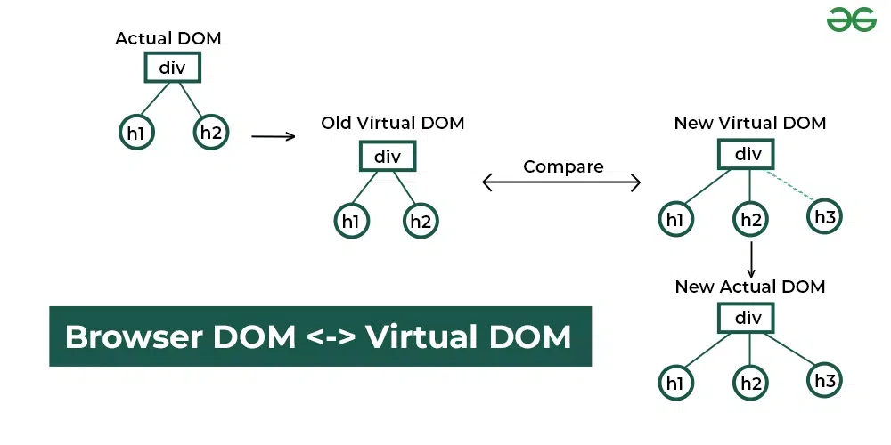
Virtual DOM
The Virtual DOM (VDOM) is a programming concept used in modern web development frameworks like React and Vue.js to optimize and speed up user interface updates. It acts as a lightweight, in-memory copy of the actual DOM (Document Object Model), which is the browser's representation of the webpage structure
How Virtual Dom Works?
Intial Rendering
State or Data Change
Diffing
Reconcilation

Slide 10
Component
A component in React is an independent, reusable building block that defines a part of the user interface (UI) and its behavior.
Why React uses Component-Based Architecture
Reusability
Maintainability
Isolation
Composability
Declarative UI

Slide 11
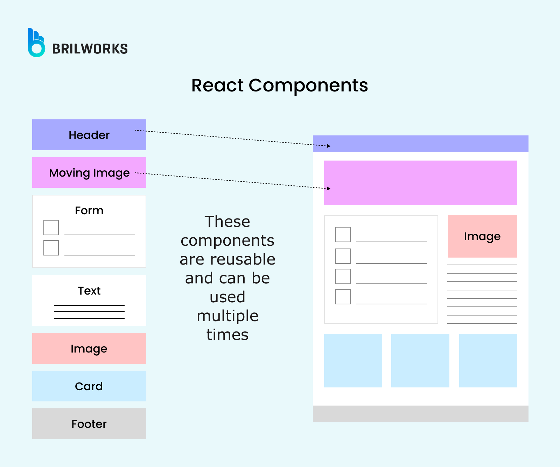

Slide 12
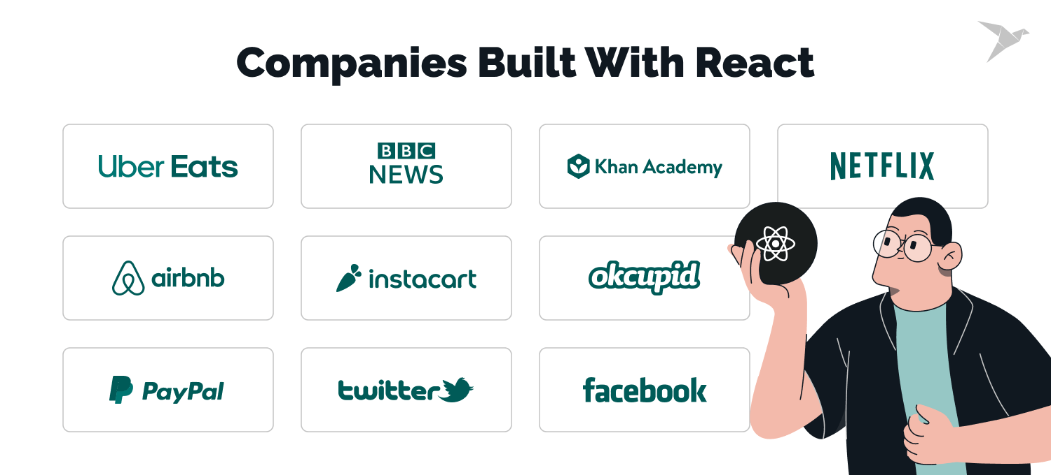
Rich Ecosystem

Slide 13
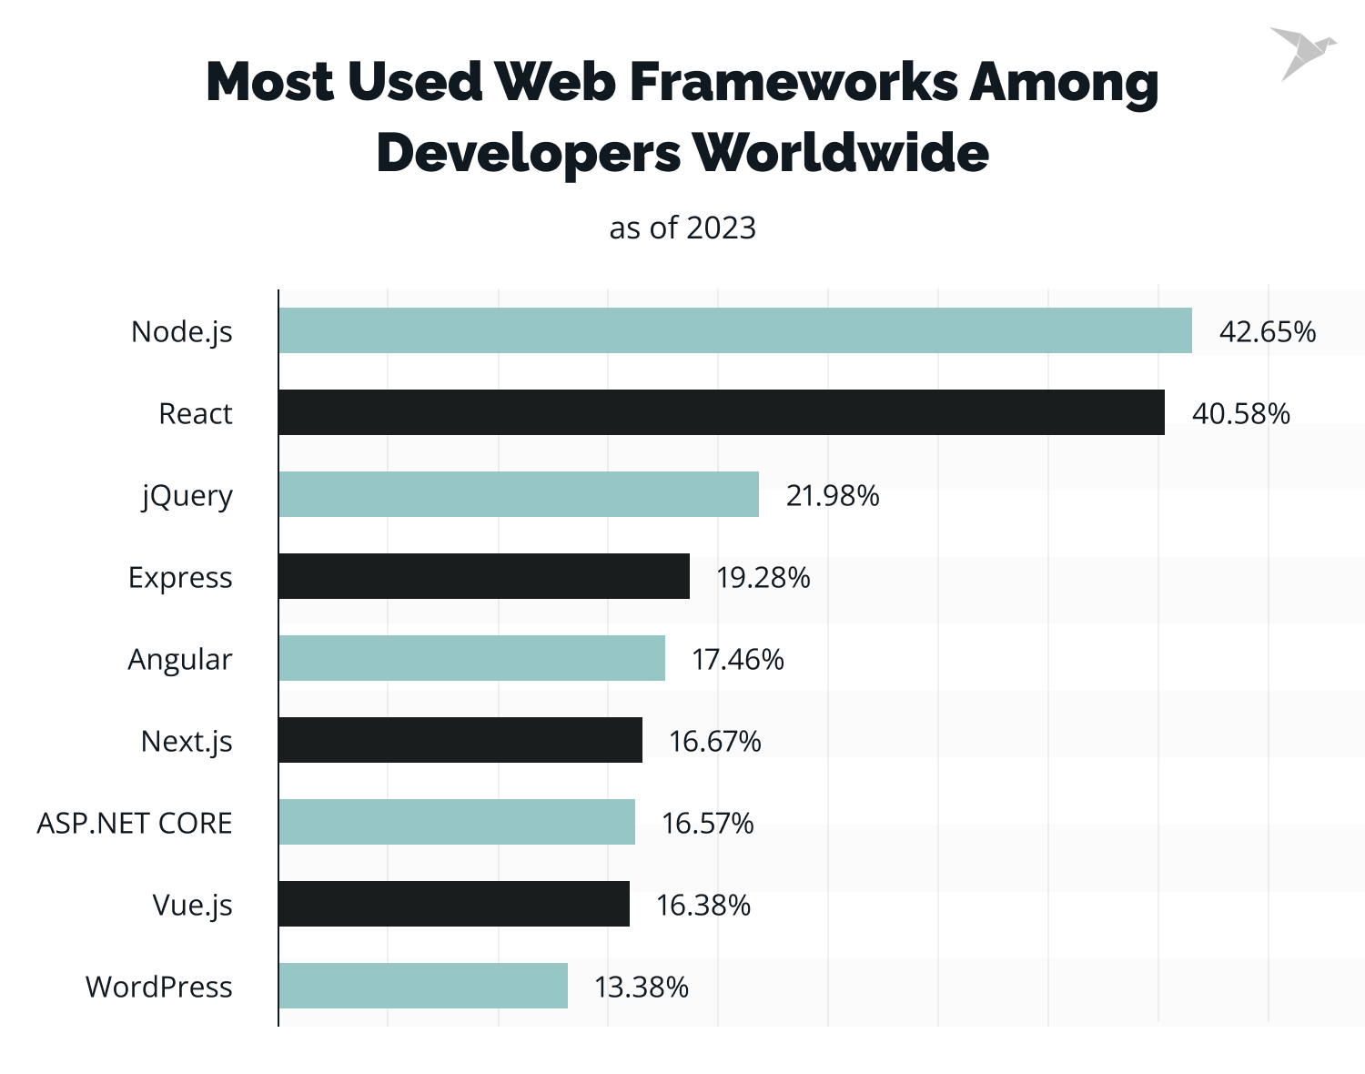

Slide 14
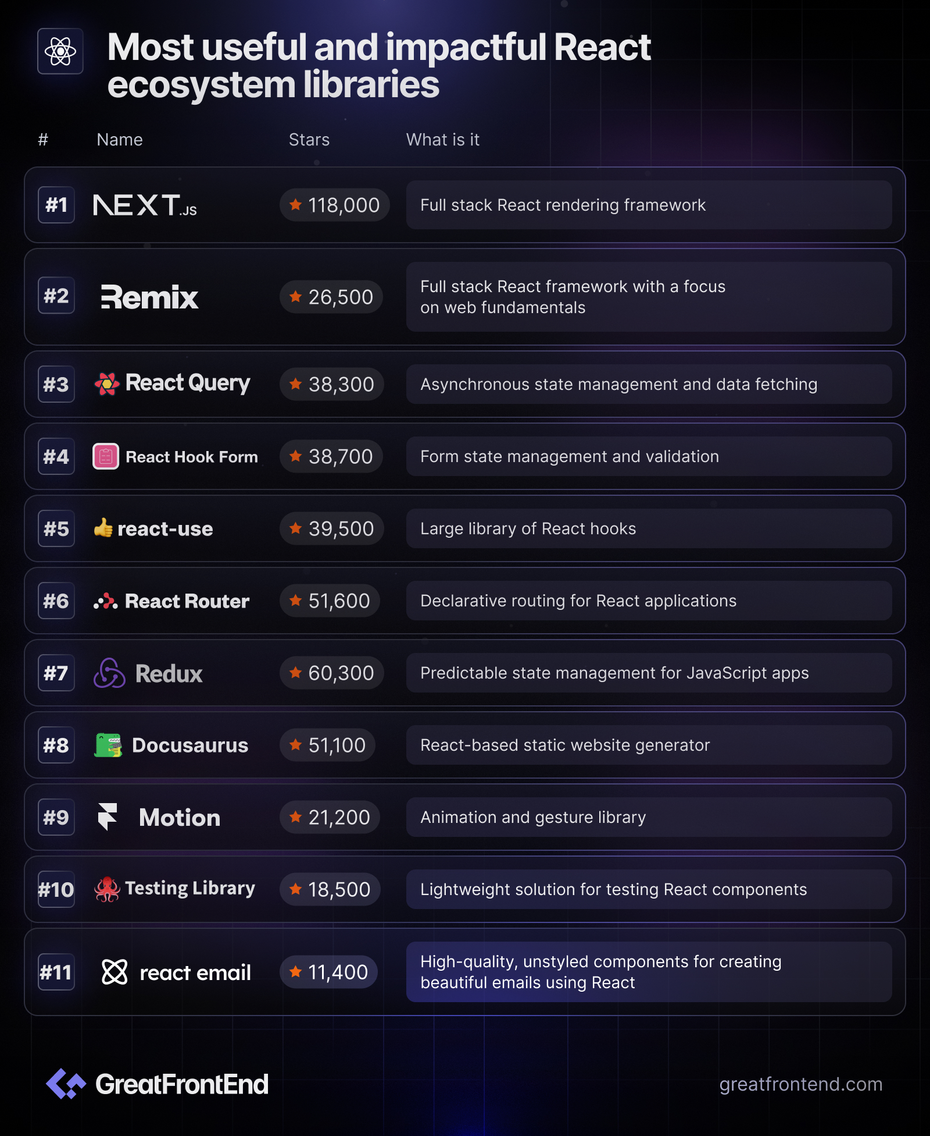
React EcoSytem

